Slide 1
Business Systems Intelligence
Lecture 2
Data Warehousing - I

Slide 2
What did we do last time?

Slide 3
Summary
Business Systems Intelligence: Data Warehousing + Data Mining + Business Sense
We are drowning in data, but starving for knowledge
A BI process includes data cleaning, data integration, data selection, transformation, data mining, pattern evaluation, and knowledge presentation
There are major steps yet to be made in BI and some major issues yet to be resolved

Slide 4
Outline
Today we will begin to look at data warehouses, and in particular:
What is a data warehouse?
Data warehouse architecture
Building a data warehouse
OLTP versus Data Warehouse
Advantages and Issues
Notes:
OLTP: Online transaction processing

Slide 5
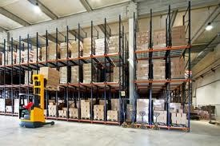
What is a data warehouse?

Slide 6
Evolution of Data Warehouses
Since the 1970s, organizations have gained competitive advantage through automation of business processes to offer more efficient and cost-effective services to customers.
This resulted in accumulation of growing amounts of data in operational databases.
Organizations now focus on ways to use operational data to support decision-making, as a means of gaining competitive advantage.
However, operational systems were never designed to support such business activities.
Enter the data warehouse.

Slide 7
The Data Warehouse
A data warehouse is a relational database that is designed for query and analysis rather than for transaction processing.
It usually contains historical data derived from transaction data, but it can include data from other sources.
It separates analysis workload from transaction workload and enables an organization to consolidate data from several sources to business users.

Slide 8

Data Warehouse Definitions
“A copy of transaction data, specifically structured for query and analysis”
—Ralph Kimball
Defined in many different ways, but not rigorously
“A data warehouse is a simple, complete and consistent store of data obtained from a variety of sources and made available to end users in a way they can understand and use it in a business context”
—IBM
“A data warehouse is a subject-oriented, integrated, time-variant, and non-volatile collection of data in support of management’s decision-making process”
—Bill Inmon

Slide 9
Data Warehouse Definitions
“A data warehouse is a simple, complete and consistent store of data obtained from a variety of sources and made available to end users in a way they can understand and use it in a business context”
—IBM
“A data warehouse is a subject-oriented, integrated, time-variant, and non-volatile collection of data in support of management’s decision-making process”
—Bill Inmon

Slide 10
Data Warehouse Duality
Data Warehousing has two aspects
Data Warehouse Data:
An integrated decision support database
Data Warehouse Process:
Software used to gather, clean, transform and store data from a variety of different databases

Slide 11
Data Warehouse Environment Capabilities
A data warehouse environment typically includes
Extraction
Transformation
Loading
An online analytical processing (OLAP) engine
Client analysis tools
Other applications that manage the process of gathering data and delivering it to business users
The ETL Process

Slide 12
Data warehouse architecture

Slide 13
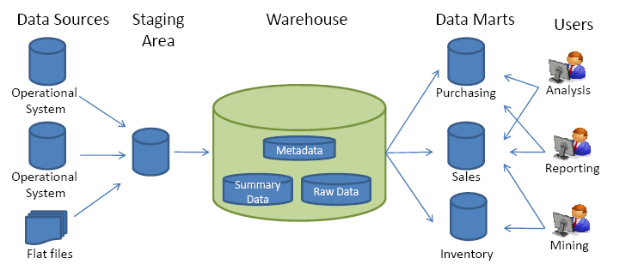
The Data Warehouse

Slide 14
The Data Warehouse
A data warehouse architecture typically consists of:
The Data Sources area contains raw transactional data that is regularly updated.
The Data Staging area is all cleansing and integration processes. It is off-limits to business users and does not provide either transactional or query services.
The Data Warehouse contains a complete integrated database set generated from Data Sources.
The Data Marts are subsets of the Data Warehouse which provide a domain specific access layer to the Data Warehouse.
The User Interfaces allow users to generate analysis and reports through BI tools from the Data Marts.

Slide 15
Building a data warehouse

Slide 16
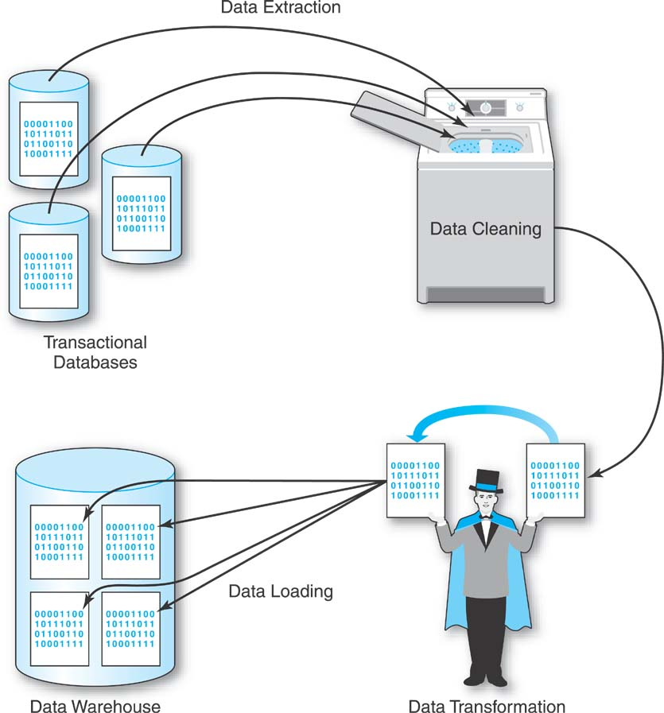
Building a Data Warehouse
The main stages of getting data into the data warehouse are
Data Extraction
Data Cleaning
Data Transformation
Data Loading

Slide 17
ETL in the Data Warehouse
The ETL Process

Slide 18
Data Extraction
Process of copying the data from the transactional databases in preparation for loading it into the data warehouse
This is not a one-time event
The data is likely to come from several transactional databases
Some of the data entering into this process may come from outside of the company: data enrichment

Slide 19
Data Extraction
Internal
Manufacturing, Accounting, HR, etc.
Legacy
Platforms
Flat Files/Databases
External
Competitor Data
Economic Data
Demographic Data
Credit Data
Purchased Databases
Dun & Bradstreet
Wall Street Journal
Data
Warehouse
Server
End User Data
Competitive Information
Economic Forecasts

Slide 20
Data Cleaning
Transactional data can have all kinds of errors in it
Data warehouses are very sensitive to data errors
Data errors must be “cleaned” or “cleansed” or “scrubbed” as the data is loaded into the data warehouse
Get data into a consistent state

Slide 21
Categories of Dirty Data
Data errors generally can be categorized as one of the following:
Incomplete
Incorrect
Incomprehensible
Inconsistent

Slide 22
Incomplete errors
These consist of:
Missing records, usually caused by human error
Missing fields, usually caused by careless design
Records or fields that, by design, are not being recorded

Slide 23
Incorrect errors
These consist of:
Wrong calculations, aggregations
Duplicate records
Wrong information entered into source system (e.g. Date format)
Incorrect pairing of codes

Slide 24
Incomprehensibility errors
These are the types of conditions that make source data difficult to read.
Multiple fields within one field
Weird formatting to conserve disk space
Unknown codes
Spreadsheets and word processing files

Slide 25
Inconsistency errors
These are the types of conditions that make source data difficult to read.
Inconsistent use of different codes (F,M or 1,2)
Inconsistent meaning of a code (Company A, B, C, D)
Overlapping codes
Different codes with the same meaning (violet vs purple)
Inconsistent names and addresses
Inconsistent business rules
Inconsistent timing
Inconsistent use of an attribute
Inconsistent date cut–offs
Inconsistent use of nulls, spaces, empty values, etc.

Slide 26
Data Transformation
Data extracted from transactional databases must go through several kinds of data transformation on its way to a data warehouse:
Data from different transactional databases being merged to form the data warehouse tables.
Data will often be aggregated as it is being extracted from the transactional databases and prepared for the data warehouse.
Measuring units used for attributes in different transactional databases must be reconciled as they are being merged into common data warehouse tables.
Notes:
Aggregation as combination

Slide 27
Data Transformation
Coding schemes used for attributes in different transactional databases must be reconciled as they are being merged into common data warehouse tables.
Sometimes values from different attributes in transactional databases are combined into a single attribute in the data warehouse (e.g., employee name).

Slide 28
Data Loading
After all of the extracting, cleaning, and transforming, the data is ready to be loaded into the data warehouse
Data will be loaded into a “loading” or working area in the database
Some of the previous steps may have been done in the database
Data may have to go through a number of stages dividing up the data and merging with other data

Slide 29
Data Loading
A schedule for regularly updating the data warehouse must be put in place
Frequency of updates is important
Time taken to get to this point is important

Slide 30
Data Warehouse Queries
Types of queries that a data warehouse is expected to answer ranges from the relatively simple to the highly complex and is dependent on the type of end-user access tools used
End-user access tools include:
Reporting, query, and application development tools
Executive information systems (EIS)
Data mining tools

Slide 31
Typical Data Warehouse Queries
Examples:
What was the total Irish revenue in 3rd quarter of 2014?
What was the total revenue for property sales for each type of property in Europe in 2013?
What are the three most popular areas in each city for the renting of property in 2013 and how does this compare with the figures for the previous two years?
What is monthly revenue for property sales at each branch office, compared with rolling 12-monthly prior figures?

Slide 32
Properties of the data warehouse

Slide 33
Data Warehouse Properties
Subject-oriented – organized based on use
Integrated – inconsistencies removed
Non-volatile – stored in read-only format
Time-variant – data are normally time series
Summarized – in decision-usable format
Large volume – data sets are quite large
Denormalized – often have redundancy
Metadata – includes data about data
Data sources – comes from originally non-integrated sources

Slide 34
Data Warehouse - Subject-Oriented
Organized around major subjects, such as customer, product, sales.
Focusing on the modeling and analysis of data for decision makers, not on daily operations or transaction processing.
Provide a simple and concise view around particular subject issues by excluding data that are not useful in the decision support process.

Slide 35
Data Warehouse - Subject-Oriented

Slide 36
Data Warehouse - Integrated
Constructed by integrating multiple, heterogeneous data sources
Relational databases, flat files…
Data cleaning and data integration techniques are applied
Ensure consistency in naming conventions, coding structures, attribute units, etc.
When data is moved to the warehouse, it is converted

Slide 37
Data Warehouse - Time Variant
The time horizon for data warehouses is much longer than that of operational systems
Operational database: current value data
Data warehouse data: provide information from a historical perspective (e.g., past 5-10 years)
Every key structure in the data warehouse
Contains an element of time, explicitly or implicitly
But the key of operational data may or may not contain a “time element”
We need to decide how frequently the data warehouse is updated!

Slide 38
Data Warehouse - Non-Volatile
A physically separate store of data transformed from the operational environment
Operational update of data does not occur in the data warehouse environment
Does not require transaction processing, recovery, and concurrency control mechanisms
Requires only two operations in data accessing:
Initial loading of data and access of data

Slide 39
Data Warehouse - Non-Volatile
Data Warehouse
Insert
Operational Application
Read
Load
Update
Delete
Insert
Read
Read Only
Operational Application
Update
Delete
End Users

Slide 40
OLTP versus data warehouse

Slide 41
Remember
OLTP
Online Transaction Processing
(A regular DB)
OLAP
Online Analytical Processing
(A data warehouse)

Slide 42
OLTP versus Data Warehouse
Data warehouses and OLTP systems have very different requirements. Examples include
Workload
DW designed for Ad-hoc queries
Workload for DW not predicable – design for flexibility
OLTP perform predefined operations
These will be specifically tuned and designed
Data Modifications
DW bulk updates on a daily basis (hourly, daily, weekly etc.)
OLTP updated on routinely by individual statement
OLTP always up to-date

Slide 43
OLTP versus Data Warehouse
Schema Design
DW is denormalised or partially denormalised to allow for optimised queries
OLTP are fully normalised to optimise modifications
Operations
DW - Bulk, access large number of records
OLTP – individual, small number of records
Historical Data
DW store months, years of data – to support historical analysis
OLTP only keep a few months of data
OLTP can only give current view of data

Slide 44
OLTP versus Data Warehouse
 | OLTP | Data Warehouse
Users | Clerk, IT professional | Knowledge worker
Function | Day to day operations | Decision support
DB Design | Application-oriented | Subject-oriented
Data | Current, up-to-date detailed, flat relational Isolated | Historical, summarized, multidimensional, integrated, consolidated
Usage | Repetitive | Ad-hoc
Access | Read/write Index/hash on prim. Key | Lots of scans
Unit of Work | Short, simple transaction | Complex query
# Records Accessed | Tens | Millions
# Users | Thousands | Hundreds
DB Size | 100MB-GB | 100GB-TB
Metric | Transaction throughput | Query throughput, response

Slide 45
Benefits of data warehousing

Slide 46
Data Warehousing Approach
Advantages
High query performance: queries are answered directly from DW
Does not interfere with local processing at sources
Provided that the local processing has a downtime and the DW update is possible during this downtime
Good separation of issues
Complex queries are dealt with in the DW
Querying/Analysing historic data (OLAP)
Mining historic data
OLTP at information sources – independent of DW
Data is available in the DW
Can annotate, summarize, restructure, clean, etc.
Can store historical data
Has caught on in industry

Slide 47
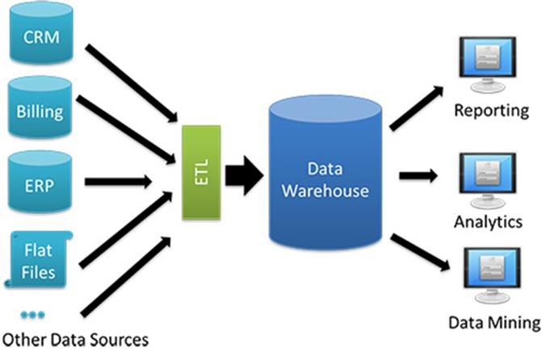
Data Warehousing Approach
Gives the data you want, in a suitable format
Removes inconsistency of reporting
Gives one consistent picture of the data
Potential high returns on investment
Competitive advantage
Increased productivity of corporate decision-makers

Slide 48
Data Warehousing Approach
Disadvantages
DW contains possibly outdated data – lacks latest data
Depends on refresh rate
Some of the source data might get lost
Setup cost

Slide 49
Issues with data warehousing

Slide 50
Issues with Data Warehousing
Underestimation of resources for data loading
Hidden problems with source systems
Required data not captured
Increased end-user demands
Data homogenization
High demand for resources
Data ownership
High maintenance
Long duration projects
Complexity of integration

Slide 51
Data Warehousing and BSI
DW provides integrated storage of current and historical data organized by subject area.
Ensures credible quality data for Business Intelligence.
Ensures a stable, high-performance environment for Business Intelligence.

Slide 52
Data Warehouse Management
Data warehouse management tasks:
Monitoring data loading from multiple sources
Data quality and integrity checks
Managing and updating meta-data
Monitoring database performance to ensure efficient query response times and resource utilisation
Auditing data warehouse usage to provide user chargeback information
Replicating and distributing data
Maintaining efficient data storage management
Notes:
Chargeback: allocating the cost of an organization's centrally located resources to the individuals or departments which use them

Slide 53
Data Warehouse Management
Purging data
Archiving and backing-up data
Implementing recovery following failure
Security management
Notes:
Purge data after 10 years, for example, due to policy.

Slide 54
Data Warehousing Tools and Technologies
Historically, building a data warehouse was a complex task because ‘end-to-end’ tools were rare
Necessary to built a data warehouse using multiple products from different vendors
Ensuring that these products worked well together and were fully integrated was a major challenge
Fortunately, out of the box solutions are becoming more prevalent

Slide 55
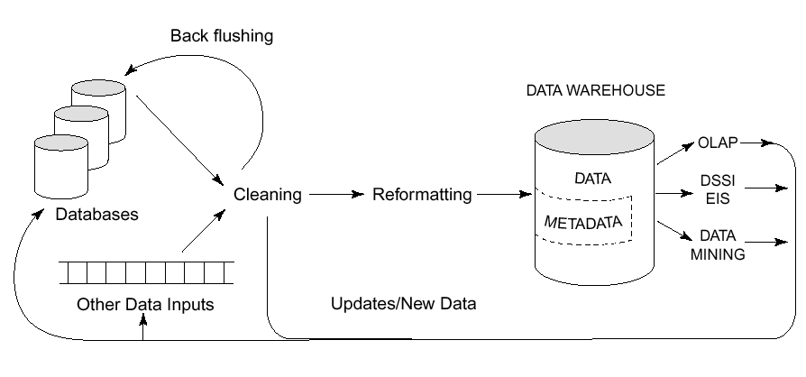
Extraction, Cleansing & Transformation Tools
Tasks of capturing data from source systems, cleansing and transforming it, and loading results into target system can be carried out either by separate products, or by a single integrated solution.
Integrated solutions include:
Code generators
Database data replication tools
Dynamic transformation engines

Slide 56
Data Warehouse DBMS Requirements
Load performance
Data quality management
Query performance
Terabyte scalability
Mass user scalability
Networked data warehouse
Data Warehouse administration
Integrated dimensional analysis
Advanced query functionality

Slide 57
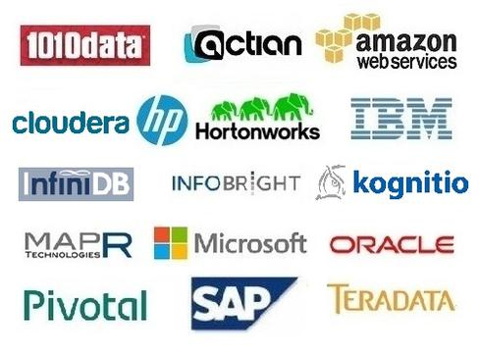
Data Warehousing Providers
Teradata
Oracle
Amazon webservices
https://www.monitis.com/blog/top-5-data-warehouses-on-the-market-today/

Slide 58
Required Skills for DW Personnel
Three kinds of employee expertise is required:
Business expertise
An understanding of the company’s business processes that underlies an understanding of the company’s transactional data and databases
An understanding of the company’s business goals to help in determining what data should be stored in the data warehouse for eventual OLAP and data mining purposes
Data expertise
An understanding of the company’s transactional data and databases for selection and integration into the data warehouse

Slide 59
Required Skills for DW Personnel
An understanding of the company’s transactional data and databases to design and manage data cleaning and data transformation, as necessary.
Familiarity with outside data sources for the acquisition of enrichment data.
Technical expertise
An understanding of data warehouse design principles for the initial design.
An understanding of OLAP and data mining techniques so that the data warehouse design will properly support these processes.

Slide 60
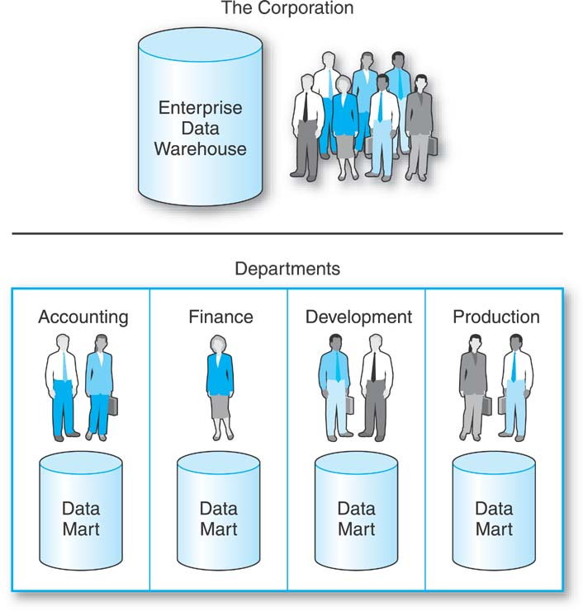
Enterprise Data Warehouse
Top-down development implies the EDW was created first and later data is extracted to create one or more Data Marts
Bottom-up approach is where a series of independent Data Marts are developed, building up into an EDW

Slide 61
Data Mart
A subset of a data warehouse that supports the requirements of a particular department or business function
Characteristics include:
Focuses on just the requirements of one department or business function
Does not normally contain detailed operational data unlike data warehouses
More easily understood and navigated

Slide 62
Reasons for Creating Data Marts
Reasons for creating a data mart
To give users access to the data they need to analyse most often
To provide data in a form that matches the collective view of the data by a group of users in a department or business function area
To improve end-user response time due to the reduction in the volume of data to be accessed
To provide appropriately structured data as dictated by the requirements of the end-user access tools

Slide 63
Reasons for Creating Data Marts
Building a data mart is simpler compared with establishing a corporate data warehouse
The cost of implementing data marts is normally less than that required to establish a data warehouse
Potential users of a data mart are more clearly defined and can be more easily targeted to obtain support for a data mart project rather than a corporate data warehouse project

Slide 64

Typical Data Warehouse & Data Mart Architecture
Operational
System
Data Mart
End Users
Production
Databases/
Files
Data Warehouse
Customized Database
Data Mart
Operational
System
End Users
Production
Databases/
Files
Customized Database

Slide 65
Issues with Data Marts
Data Mart functionality
Data Mart size
Data Mart load performance
Users access to data in multiple data marts
Data Mart internet/intranet access
Data Mart administration
Data Mart setup and configuration

Slide 66
Closing Notes

Slide 67
Summary
Today we started looking into data warehouses
What is a data warehouse?
OLTP versus Data warehouses
Data warehouse architecture
Building a data warehouse
Data warehouses, data marts and virtual warehouses

Slide 68

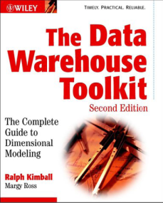

More Information
“An Overview of Data Warehousing and OLAP Technology” Surajit Chaudhuri & Umeshwar Dayal, ACM SIGMOD Record, Volume 26, Issue 1, pp 65–74 (1997)
“The Data Warehouse Toolkit”, Ralph Kimball, Wiley, 2002
http://nickwang.googlepages.com/WileySons-TheDataWarehouseToolkit.Se.pdf
The Data Warehousing Information Center
www.dwinfocenter.org

Slide 69
Questions?

